Slide 1
CS 4700: Foundations of Artificial Intelligence
Prof. Bart Selman
selman@cs.cornell.edu
Machine Learning:
Decision Trees
R&N 18.3

Slide 2
Big Picture of Learning
Learning can be seen as fitting a function to the data. We can consider
different target functions and therefore different hypothesis spaces.
Examples:
Propositional if-then rules
Decision Trees
First-order if-then rules
First-order logic theory
Linear functions
Polynomials of degree at most k
Neural networks
Java programs
Turing machine
Etc
A learning problem
is realizable if its hypothesis space contains the true function.
Tradeoff between expressiveness of
a hypothesis space and the
complexity of finding simple, consistent hypotheses
within the space.

Slide 3
Decision Tree Learning
Task:
Given: collection of examples (x, f(x))
Return: a function h (hypothesis) that approximates f
h is a decision tree
Input: an object or situation described by a set of attributes (or features)
Output: a “decision” – the predicts output value for the input.
The input attributes and the outputs can be discrete or continuous.
We will focus on decision trees for Boolean classification:
each example is classified as positive or negative.

Slide 4
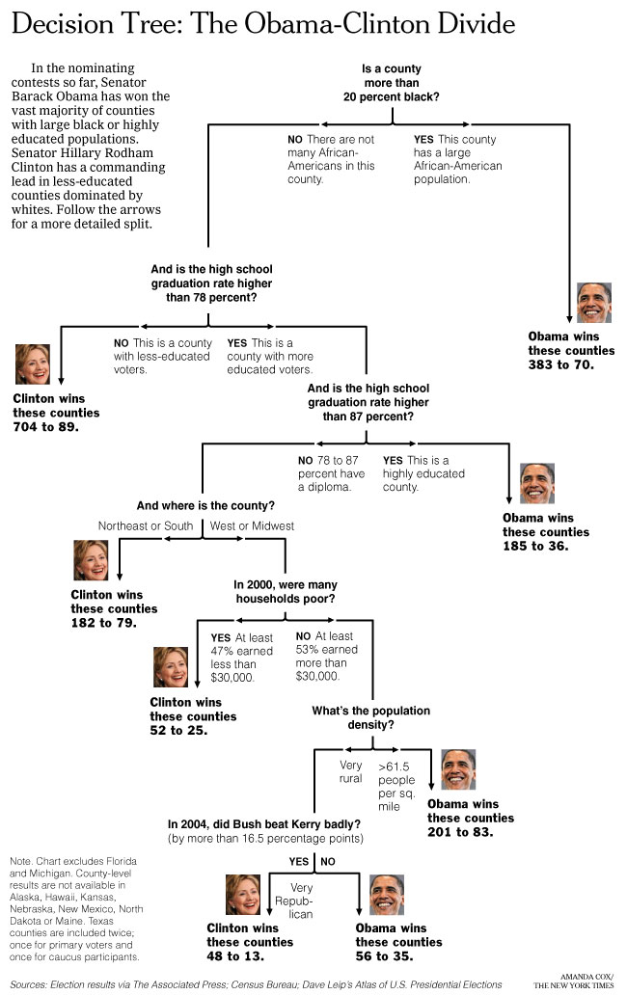
Can we learn
how counties vote?
New York Times
April 16, 2008
Decision Trees:
a sequence of tests.
Representation very natural for humans.
Style of many “How to” manuals and trouble-shooting
procedures.

Slide 7
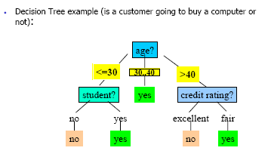
Decision Tree
What is a decision tree?
A tree with two types of nodes:
Decision nodes
Leaf nodes
Decision node: Specifies a choice or test of some attribute with 2 or more alternatives;
→ every decision node is part of a path to a leaf node
Leaf node: Indicates classification of an example

Slide 8
Inductive Learning Example
Etc.
Instance Space X: Set of all possible objects described by attributes (often called features).
Target Function f: Mapping from Attributes to Target Feature (often called label) (f is unknown)
Hypothesis Space H: Set of all classification rules h_{i} we allow.
Training Data D: Set of instances labeled with Target Feature

Slide 9
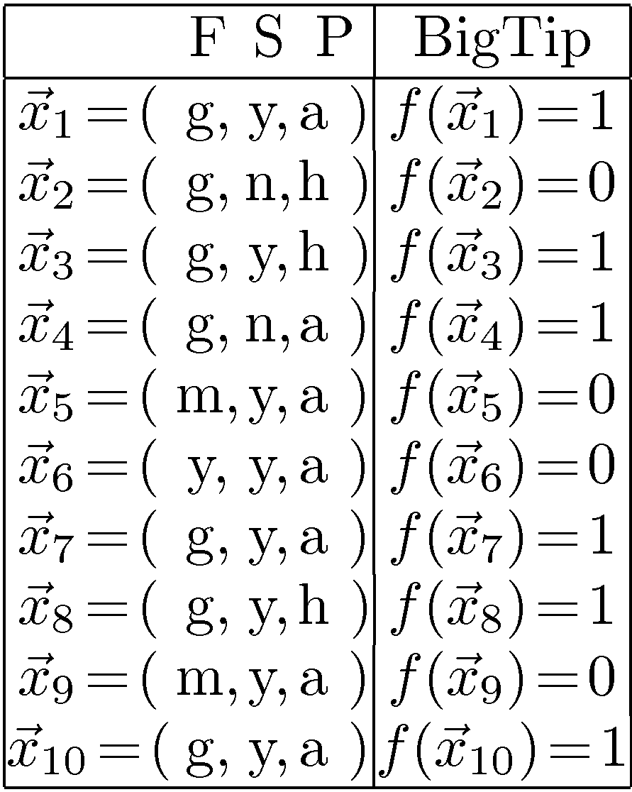
Decision Tree Example: “BigTip”
great
Food
yuck
mediocre
Speedy
no
no
no
yes
Our data
yes
Price
high
adequate
yes
no
Is the decision tree we learned consistent?
Yes, it agrees with all the examples!
Data: Not all 2x2x3 = 12 tuples
Also, some repeats! These are
literally “observations.”
Notes:
Definition of components
Internal nodes: tests on attributes
Branches: attribute value (one branch for each value)
Leaves: assign classification
Understanding example tree
Classify Example 1: yes
Classify Example 2: yes
Classify Example 3: no
Classify Example 4: yes
Classify: $x_2=(Food=great, Chat=no, Fast=no, Price=adequate, Bar=no)$ $\rightarrow$ yes
Example represents function: (Food=great) AND ((Fast=yes) OR ((Fast=no) AND (Price=adequate))) → Simplify to: (Food=great) AND ((Fast=yes) OR (Price=adequate))
How would you represent:
A AND B
A OR B
A XOR B

Slide 10
Learning decision trees: An example
Problem: decide whether to wait for a table at a restaurant. What attributes would you use?
Attributes used by R&N
Alternate: is there an alternative restaurant nearby?
Bar: is there a comfortable bar area to wait in?
Fri/Sat: is today Friday or Saturday?
Hungry: are we hungry?
Patrons: number of people in the restaurant (None, Some, Full)
Price: price range ($, $$, $$$)
Raining: is it raining outside?
Reservation: have we made a reservation?
Type: kind of restaurant (French, Italian, Thai, Burger)
WaitEstimate: estimated waiting time (0-10, 10-30, 30-60, >60)
What about
restaurant name?
It could be great for
generating a small tree
but …
Goal predicate: WillWait?
It doesn’t generalize!

Slide 11
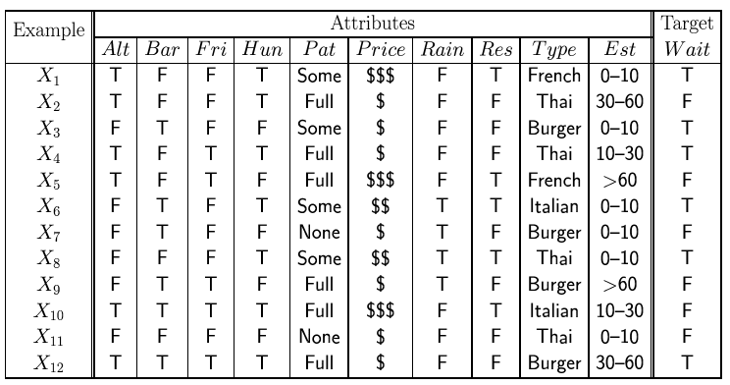
Attribute-based representations
Examples described by attribute values (Boolean, discrete, continuous)
E.g., situations where I will/won't wait for a table:
Classification of examples is positive (T) or negative (F)
12 examples
6 +
6 -

Slide 12
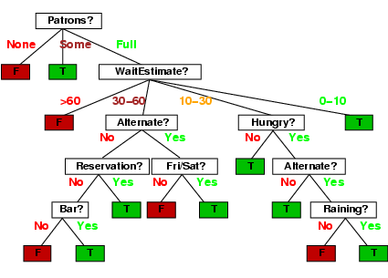
Decision trees
One possible representation for hypotheses
E.g., here is a tree for deciding whether to wait:

Slide 13
Expressiveness of Decision Trees
Any particular decision tree hypothesis for WillWait goal predicate can be
seen as a disjunction of a conjunction of tests, i.e., an assertion of the form:
∀s WillWait(s) ↔ (P1(s) ∨ P2(s) ∨ … ∨ Pn(s))
Where each condition Pi(s) is a conjunction of tests corresponding
to the path from the root of the tree to a leaf with a positive outcome.

Slide 14
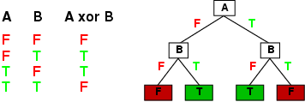
Expressiveness
Decision trees can express any Boolean function of the input attributes.
E.g., for Boolean functions, truth table row → path to leaf:

Slide 15
Number of Distinct Decision Trees
How many distinct decision trees with 10 Boolean attributes?
= number of Boolean functions with 10 propositional symbols
Input features Output
0 0 0 0 0 0 0 0 0 0 0/1
0 0 0 0 0 0 0 0 0 1 0/1
0 0 0 0 0 0 0 0 1 0 0/1
0 0 0 0 0 0 0 1 0 0 0/1
…
1 1 1 1 1 1 1 1 1 1 0/1
How many entries does this table have?
2¹⁰
So how many Boolean functions
with 10 Boolean attributes are there,
given that each entry can be 0/1?
= 2²¹⁰

Slide 16
Hypothesis spaces
How many distinct decision trees with n Boolean attributes?
= number of Boolean functions
= number of distinct truth tables with 2^{n} rows
With 6 Boolean attributes, there are 18,446,744,073,709,551,616 possible trees!
= 2^{2n}
E.g. how many Boolean functions on 6 attributes? A lot…
Googles calculator could not handle 10 attributes ☺!
There are even more decision trees! (see later)

Slide 17
Decision tree learning Algorithm
Decision trees can express any Boolean function.
Goal: Finding a decision tree that agrees with training set.
We could construct a decision tree that has one path to a leaf for each example, where the path tests sets each attribute value to the value of the example.
Overall Goal: get a good classification with a small number of tests.
What is the problem with this from a learning point of view?
Problem: This approach would just memorize example. How to deal with new examples? It doesn’t generalize!
(But sometimes hard to avoid --- e.g. parity function, 1, if an even number of inputs, or majority function, 1, if more than half of the inputs are 1).
We want a compact/smallest tree.
But finding the smallest tree consistent with the examples is NP-hard!

Slide 18
Expressiveness: Boolean Function with 2 attributes → DTs
2²²
AND
OR
A
XOR
A
A
A
A
T
F
T
F
T
F
T
F
B
B
B
B
B
B
B
B
T
F
T
F
T
F
T
F
T
F
T
F
T
F
T
F
T
F
F
F
T
T
T
F
F
T
T
F
T
T
F
F
NAND
NOR
A
XNOR
NOT A
A
A
A
T
F
T
F
T
F
T
F
B
B
B
B
B
B
B
B
T
F
T
F
T
F
T
F
T
F
T
F
T
F
T
F
F
T
T
T
F
F
F
T
F
T
F
T
F
F
T
T

Slide 19
Expressiveness: 2 attribute → DTs
2²²
AND
OR
A
XOR
A
A
A
A
T
F
T
F
T
F
T
F
B
T
B
B
B
T
F
F
T
F
T
F
T
F
T
F
T
F
T
F
F
T
T
F
NAND
NOR
A
XNOR
NOT A
A
A
A
T
F
T
F
T
F
T
F
B
T
F
B
B
B
F
T
T
F
T
F
T
F
T
F
F
T
F
T
F
T
F
T

Slide 20
Expressiveness: 2 attribute → DTs
2²²
A AND-NOT B
NOT A AND B
B
TRUE
A
A
A
A
T
F
T
F
T
F
T
F
B
B
B
B
B
B
B
B
T
F
T
F
T
F
T
F
T
F
T
F
T
F
T
F
F
T
F
F
F
F
T
F
T
F
T
F
T
T
T
T
A OR NOT B
NOR A OR B
NOT B
A
FALSE
A
A
A
T
T
F
T
F
T
F
F
B
B
B
B
B
B
B
B
T
F
T
F
T
F
T
F
T
F
T
F
T
F
T
F
T
F
T
T
T
T
F
T
F
T
F
T
F
F
F
F

Slide 21
Expressiveness: 2 attribute → DTs
2²²
A AND-NOT B
NOT A AND B
B
TRUE
A
A
B
T
T
F
T
F
T
F
B
F
F
B
T
F
T
F
T
F
F
T
T
F
A OR NOT B
NOR A OR B
NOT B
FALSE
F
A
A
B
T
F
T
F
T
F
B
T
T
B
T
F
T
F
T
F
T
F
F
T

Slide 22
Basic DT Learning Algorithm
“most significant”
In what sense?
Goal: find a small tree consistent with the training examples
Idea: (recursively) choose "most significant" attribute as root of (sub)tree;
Use a top-down greedy search through the space of possible decision trees.
Greedy because there is no backtracking. It picks highest values first.
Variations of known algorithms ID3, C4.5 (Quinlan -86, -93)
Top-down greedy construction
Which attribute should be tested?
Heuristics and Statistical testing with current data
Repeat for descendants
(ID3 Iterative Dichotomiser 3)

Slide 23
Big Tip Example
10 examples:
6+
1
3
4
7
8
10
4-
2
5
6
9
Attributes:
Food with values g,m,y
Speedy? with values y,n
Price, with values a, h
Let’s build our decision tree
starting with the attribute Food,
(3 possible values: g, m, y).
Notes:
Definition of components
Internal nodes: tests on attributes
Branches: attribute value (one branch for each value)
Leaves: assign classification
Understanding example tree
Classify Example 1: yes
Classify Example 2: yes
Classify Example 3: no
Classify Example 4: yes
Classify: $x_2=(Food=great, Chat=no, Fast=no, Price=adequate, Bar=no)$ $\rightarrow$ yes
Example represents function: (Food=great) AND ((Fast=yes) OR ((Fast=no) AND (Price=adequate))) → Simplify to: (Food=great) AND ((Fast=yes) OR (Price=adequate))
How would you represent:
A AND B
A OR B
A XOR B

Slide 24
Top-Down Induction of Decision Tree: Big Tip Example
Node “done” when uniform label or “no
further
uncertainty.”
1
3
4
7
8
10
2
5
6
9
10 examples:
6+
Food
4-
y
1
3
4
7
8
10
m
g
2
No
No
Speedy
6
5
9
n
4
y
Yes
Price
2
a
h
1
3
7
8
10
Yes
No
4
2
How many + and - examples
per subclass, starting with y?
Let’s consider next
the attribute Speedy
Notes:
Definition of components
Internal nodes: tests on attributes
Branches: attribute value (one branch for each value)
Leaves: assign classification
Understanding example tree
Classify Example 1: yes
Classify Example 2: yes
Classify Example 3: no
Classify Example 4: yes
Classify: $x_2=(Food=great, Chat=no, Fast=no, Price=adequate, Bar=no)$ $\rightarrow$ yes
Example represents function: (Food=great) AND ((Fast=yes) OR ((Fast=no) AND (Price=adequate))) → Simplify to: (Food=great) AND ((Fast=yes) OR (Price=adequate))
How would you represent:
A AND B
A OR B
A XOR B

Slide 25
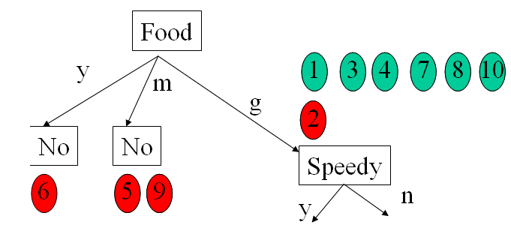
Top-Down Induction of DT (simplified)
Yes
TDIDF(D,c_{def})
IF(all examples in D have same class c)
Return leaf with class c (or class c_{def}, if D is empty)
ELSE IF(no attributes left to test)
Return leaf with class c of majority in D
ELSE
Pick A as the “best” decision attribute for next node
FOR each value v_{i} of A create a new descendent of node
Subtree t_{i} for v_{i} is TDIDT(D_{i},c_{def})
RETURN tree with A as root and t_{i} as subtrees
Training Data:

Slide 26
Picking the Best Attribute to Split
Ockham’s Razor:
All other things being equal, choose the simplest explanation
Decision Tree Induction:
Find the smallest tree that classifies the training data correctly
Problem
Finding the smallest tree is computationally hard ☹!
Approach
Use heuristic search (greedy search)
Key Heuristics:
Pick attribute that maximizes information (Information Gain)
i.e. “most informative”
Other statistical tests
Notes:
Trivial Tree: Full tree with full depth, just label the nodes.

Slide 27
Attribute-based representations
Examples described by attribute values (Boolean, discrete, continuous)
E.g., situations where I will/won't wait for a table:
Classification of examples is positive (T) or negative (F)
12 examples
6 +
6 -

Slide 28
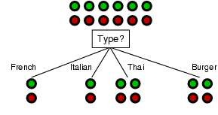
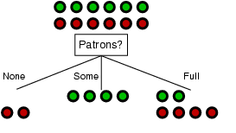
Choosing an attribute: Information Gain
Goal: trees with short paths to leaf nodes
Is this a good attribute
to split on?
Which one should we pick?
A perfect attribute would ideally divide the
examples into sub-sets that are all positive or all negative…
i.e. maximum information gain.

Slide 29
Information Gain
Most useful in classification
how to measure the ‘worth’ of an attribute information gain
how well attribute separates examples according to their classification
Next
precise definition for gain
→ measure from Information Theory
Shannon and Weaver 49
One of the most successful and impactful
mathematical theories known.

Slide 30
Information
“Information” answers questions.
The more clueless I am about a question, the more information
the answer to the question contains.
Example – fair coin → prior <0.5,0.5>
By definition Information of the prior (or entropy of the prior):
I(P1,P2) = - P1 log₂(P1) –P2 log₂(P2) =
I(0.5,0.5) = -0.5 log₂(0.5) – 0.5 log₂(0.5) = 1
We need 1 bit to convey the outcome of the flip of a fair coin.
Why does a biased coin have less information?
(How can we code the outcome of a biased coin sequence?)
Scale: 1 bit = answer to Boolean question with prior <0.5, 0.5>

Slide 31
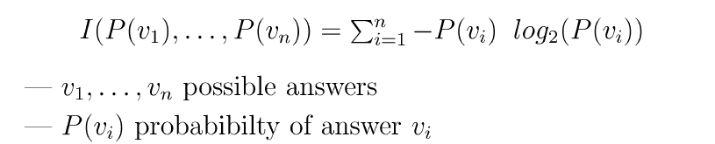
Information (or Entropy)
Information in an answer given possible answers v₁, v₂, … v_{n}:
(Also called entropy of the prior.)
Example – biased coin → prior <1/100,99/100>
I(1/100,99/100) = -1/100 log₂(1/100) –99/100 log₂(99/100)
= 0.08 bits (so not much information gained from “answer.”)
Example – fully biased coin → prior <1,0>
I(1,0) = -1 log₂(1) – 0 log₂(0) = 0 bits
0 log₂(0) =0
i.e., no uncertainty left in source!

Slide 32
Shape of Entropy Function
Roll of an unbiased die
1
0
0
1/2
1
p
The more uniform the probability distribution,
the greater is its entropy.

Slide 33

Information or Entropy
Information or Entropy measures the “randomness” of an arbitrary collection of examples.
We don’t have exact probabilities but our training data provides an estimate of the probabilities of positive vs. negative examples given a set of values for the attributes.
For a collection S, entropy is given as:
For a collection S having positive and negative examples
p - # positive examples;
n - # negative examples

Slide 34
Attribute-based representations
Examples described by attribute values (Boolean, discrete, continuous)
E.g., situations where I will/won't wait for a table:
Classification of examples is positive (T) or negative (F)
12 examples
6 +
6 -
What’s the entropy
of this collection of
examples?
p = n = 6; I(0.5,0.5) = -0.5 log2(0.5) –0.5 log2(0.5) = 1
So, we need 1 bit of info to classify a randomly picked example,
assuming no other information is given about the example.

Slide 35

Choosing an attribute: Information Gain
Intuition: Pick the attribute that reduces the entropy (the uncertainty) the
most.
So we measure the information gain after testing a given attribute A:
Remainder(A) → gives us the remaining uncertainty after getting info on attribute A.

Slide 36

Choosing an attribute: Information Gain
Remainder(A)
→ gives us the amount information we still need after testing on A.
Assume A divides the training set E into E₁, E₂, … E_{v}, corresponding to the different v distinct values of A.
Each subset E_{i} has p_{i} positive examples and n_{i} negative examples.
So for total information content, we need to weigh the contributions of the different subclasses induced by A
Weight (relative size) of each subclass

Slide 37

Choosing an attribute: Information Gain
Measures the expected reduction in entropy. The higher the Information Gain (IG), or just Gain, with respect to an attribute A , the more is the expected reduction in entropy.
where Values(A) is the set of all possible values for attribute A,
S_{v} is the subset of S for which attribute A has value v.
Weight of each subclass

Slide 38
Interpretations of gain
Gain(S,A)
expected reduction in entropy caused by knowing A
information provided about the target function value given the value of A
number of bits saved in the coding a member of S knowing the value of A
Used in ID3 (Iterative Dichotomiser 3) Ross Quinlan

Slide 39

Information gain
What if we used attribute “example label” uniquely
specifying the answer? Info gain? Issue?
High branching: can correct with “info gain ratio”
For the training set, p = n = 6, I(6/12, 6/12) = 1 bit
Consider the attributes Type and Patrons:
Patrons has the highest IG of all attributes and so is chosen by the DTL algorithm as the root.
Info gain?

Slide 40
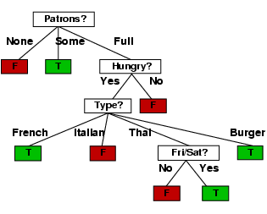
Example contd.
Decision tree learned from the 12 examples:
“personal R&N Tree”
Substantially simpler than “true” tree ---
but a more complex hypothesis isn’t justified
from just the data.

Slide 41
Inductive Bias
Roughly: prefer
shorter trees over deeper/more complex ones
ones with high gain attributes near root
Difficult to characterize precisely
attribute selection heuristics
interacts closely with given data

Slide 42
Evaluation Methodology
General for Machine Learning

Slide 43
Evaluation Methodology
How to evaluate the quality of a learning algorithm, i.e.,:
How good are the hypotheses produce by the learning algorithm?
How good are they at classifying unseen examples?
Standard methodology (“Holdout Cross-Validation”):
1. Collect a large set of examples.
2. Randomly divide collection into two disjoint sets: training set and test set.
3. Apply learning algorithm to training set generating hypothesis h
4. Measure performance of h w.r.t. test set (a form of cross-validation)
→ measures generalization to unseen data
Important: keep the training and test sets disjoint! “No peeking”!
Note: The first two questions about any learning result: Can you describe
your training and your test set? What’s your error on the test set?
Notes:
Peeking – example of peeking:
We generate four different hypothesis – for example by using different criteria to pick the next attribute to branch on.
We test them on the test set and we select the best hypothesis – voila’ – there was picking since the hypothesis was selcted on the basis of its performance on the test set, so information about the test set has leaked into the learning algorithm.

Slide 44
Peeking
Example of peeking:
We generate four different hypotheses – for example by using different criteria to pick the next attribute to branch on.
We test the performance of the four different hypothesis on the test set and we select the best hypothesis.
Voila: Peeking occurred! Why?
The hypothesis was selected on the basis of its performance on the test set,
so information about the test set has leaked into the learning algorithm.
So a new (separate!) test set would be required!
Note: In competitions, such as the “Netflix $1M challenge,”
test set is not revealed to the competitors. (Data is held back.)
Notes:
In practice, sometimes too difficult,
So people continue to run experiments on tainted data sets…

Slide 45
Test/Training Split
Real-world Process
drawn randomly
split randomly
Data D
split randomly
Training Data D_{train}
Test Data D_{test}
(x₁,y₁), …, (x_{n},y_{n})
D_{train}
h
(x₁,y₁),…(x_{k},y_{k})
Learner
Notes:
Goal: Decouple algorithm testing from real-world process time constraints
Example: Drug effectiveness prediction (some problems with non iid for spam and stock)

Slide 46
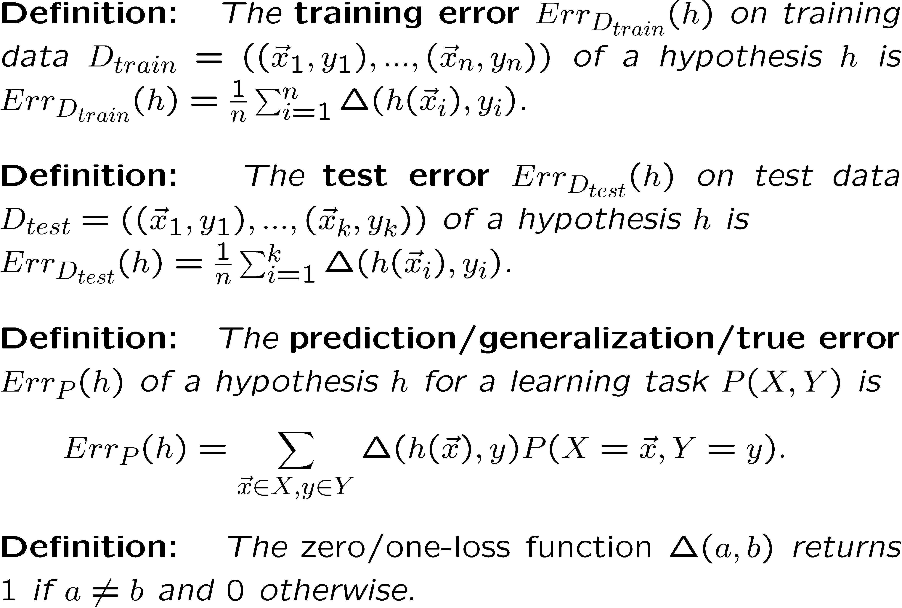
Measuring Prediction Performance

Slide 47
Performance Measures
Error Rate
Fraction (or percentage) of false predictions
Accuracy
Fraction (or percentage) of correct predictions
Precision/Recall
Example: binary classification problems (classes pos/neg)
Precision: Fraction (or percentage) of correct predictions among all examples predicted to be positive
Recall: Fraction (or percentage) of correct predictions among all real positive examples
(Can be generalized to multi-class case.)

Slide 48
Learning Curve Graph
Learning curve graph
average prediction quality – proportion correct on test set –
as a function of the size of the training set..
Notes:
Peeking – example of peeking:
We generate four different hypothesis – for example by using different criteria to pick the next attribute to branch on.
We test them on the test set and we select the best hypothesis – voila’ – there was picking since the hypothesis was selcted on the basis of its performance on the test set, so information about the test set has leaked into the learning algorithm.

Slide 49
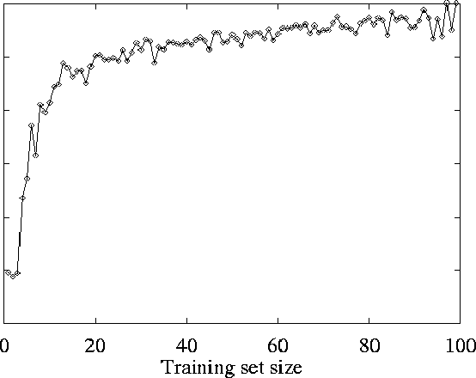
Restaurant Example: Learning Curve
On test set
Prediction quality:
Average Proportion correct on test set
As the training set increases,
so does the quality of prediction:
→“Happy curve” ☺!
→ the learning algorithm is able to capture
the pattern in the data

Slide 50
How well does it work?
Many case studies have shown that decision trees are at least as accurate as human experts.
A study for diagnosing breast cancer had humans correctly classifying the examples 65% of the time, and the decision tree classified 72% correct.
British Petroleum designed a decision tree for gas-oil separation for offshore oil platforms that replaced an earlier rule-based expert system.
Cessna designed an airplane flight controller using 90,000 examples and 20 attributes per example.

Slide 51
Summary
Decision tree learning is a particular case of supervised learning,
For supervised learning, the aim is to find a simple hypothesis approximately consistent with training examples
Decision tree learning using information gain
Learning performance = prediction accuracy measured on test set

Slide 52
Extensions of the Decision Tree Learning Algorithm (Briefly)
Noisy data
Overfitting and Model Selection
Cross Validation
Missing Data (R&N, Section 18.3.6)
Using gain ratios (R&N, Section 18.3.6)
Real-valued data (R&N, Section 18.3.6)
Generation of rules and pruning

Slide 53
Noisy data
Many kinds of "noise" that could occur in the examples:
Two examples have same attribute/value pairs, but different classifications
→report majority classification for the examples corresponding to the node
deterministic hypothesis.
→report estimated probabilities of each classification using the relative frequency (if considering stochastic hypotheses)
Some values of attributes are incorrect because of errors in the data acquisition process or the preprocessing phase
The classification is wrong (e.g., + instead of -) because of some error
One important reason why you don’t want to “overfit” your learned model.

Slide 54
Overfitting
Ex.: Problem of trying to predict the roll of a die. The experiment data include:
Day of the week; (2) Month of the week; (3) Color of the die;
….
DTL may find an hypothesis that fits the data but with irrelevant attributes.
Some attributes are irrelevant to the decision-making process, e.g., color
of a die is irrelevant to its outcome but they are used to differentiate examples → Overfitting.
Overfitting means fitting the training set “too well”
→ performance on the test set degrades.
Example overfitting risk: Using restaurant name.

Slide 55
If the hypothesis space has many dimensions because of a large number of
attributes, we may find meaningless regularity in the data that is irrelevant
to the true, important, distinguishing features.
Fix by pruning to lower # nodes in the decision tree or put a
limit on number of nodes created.
For example, if Gain of the best attribute at a node is below a threshold, stop and make this node a leaf rather than generating children nodes.
Overfitting is a key problem in learning. There are formal results on the number of examples needed to properly train an hypothesis of a certain complexity (“number of parameters” or # nodes in DT). The more params, the more data is needed. We’ll see some of this in our discussion of PAC learning.

Slide 56
Overfitting
Let’s consider D, the entire distribution of data, and T, the training set.
Hypothesis h ∈ H overfits D if
∃ h’≠ h ∈ H such that
error_{T}(h) < error_{T}(h’) but
error_{D}(h) > error_{D}(h’)
Note: estimate error on full distribution by using test data set.

Slide 57
Data overfitting is the arguably the most common pitfall in
machine learning.
Why?
Temptation to use as much data as possible to train on. (“Ignore test till end.” Test set too small.) Data “peeking” not noticed.
Temptation to fit very complex hypothesis (e.g. large decision tree). In general, the larger the tree, the better the fit to the training data.
It’s hard to think of a better fit to the training data as a “worse”
result. Often difficult to fit training data well, so it seems that
“a good fit to the training data means a good result.”
Note: Modern “savior:” Massive amounts of data to train on!
Somewhat characteristic of ML AI community vs. traditional
statistics community. Anecdote: Netflix competition.

Slide 58
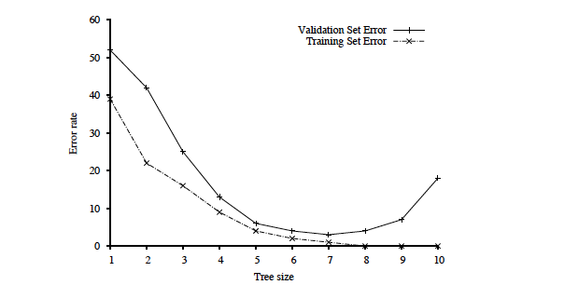
Key figure in machine learning
We set tree size as
a parameter in our
DT learning alg.
Optimal tree size
Error rate
Overfitting kicks in…
Tree size
error_{T}(h) < error_{T}(h’) but
error_{D}(h) > error_{D}(h’)
Note: with larger and larger trees,
we just do better and better on the training set!
But note the performance on the validation set…

Slide 59
Procedure for finding the optimal tree size is called “model selection.”
See section 18.4.1 R&N and Fig. 18.8.
To determine validation error for each tree size, use k-fold cross-validation. (Uses the data better than “holdout cross-validation.”)
Uses “all data - test set” --- k times splits that set into a training
set and a validation set.
After right decision tree size is found from the error rate curve on
validation data, train on all training data to get final decision tree
(of the right size).
Finally, evaluate tree on the test data (not used before) to get
true generalization error (to unseen examples).

Slide 60
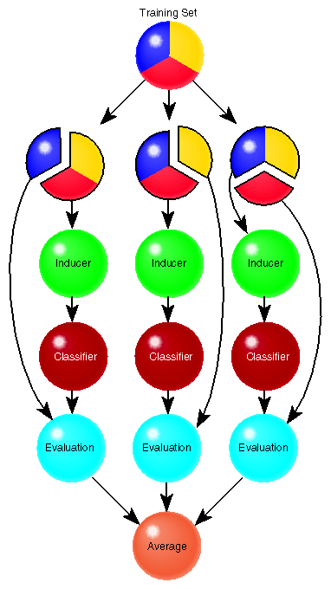
Cross Validation
Learner L is e.g. DT learner for “tree with
7 nodes” max.
A method for estimating the accuracy
(or error) of a learner (using validation set).
CV( data S, alg L, int k )
Divide S into k disjoint sets { S₁, S₂, …, S_{k} }
For i = 1..k do
Run L on S_{-i} = S – S_{i}
obtain L(S_{-i}) = h_{i}
Evaluate h_{i} on S_{i}
err_{Si}(h_{i}) = 1/|S_{i}| ∑ _{⟨ x,y⟩ ∈ Si} I(h_{i}(x) ≠ y)
Return Average 1/k ∑_{i} err_{Si}(h_{i})

Slide 61
Specific techniques for dealing with overfitting (Model selection provides general framework)
1) Decision tree pruning or grow only up to certain size.
Prevent splitting on features that are not clearly relevant.
Testing of relevance of features --- “does split provide new information”:
statistical tests ---> Section 18.3.5 R&N test.
2) Grow full tree, then post-prune rule post-pruning
3)
MDL (minimal description length):
minimize
size(tree) + size(misclassifications(tree))

Slide 62
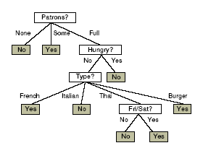
Converting Trees to Rules
Every decision tree corresponds to set of rules:
IF (Patrons = None)
THEN WillWait = No
IF (Patrons = Full) & (Hungry = No) &(Type = French)
THEN WillWait = Yes
...

Slide 63
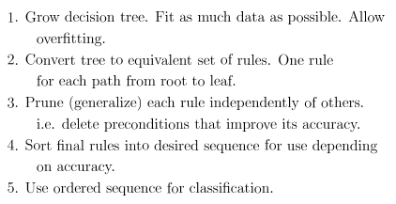
Fighting Overfitting: Using Rule Post-Pruning

Slide 64
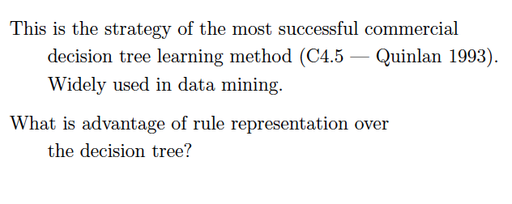

Slide 65
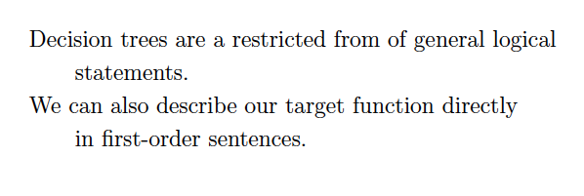
Logical aside

Slide 66
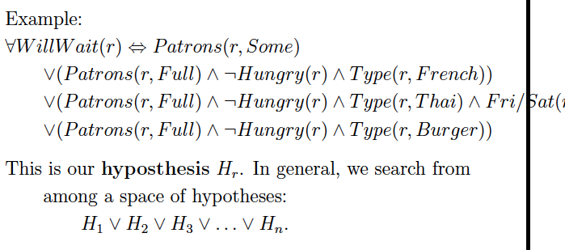

Slide 67
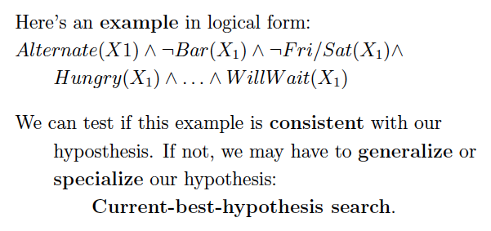
End logical aside

Slide 68

C4.5
C4.5 is an extension of ID3 that accounts for unavailable values, continuous attribute value ranges, pruning of decision trees, rule derivation, and so on.
C4.5: Programs for Machine Learning
J. Ross Quinlan, The Morgan Kaufmann Series
in Machine Learning, Pat Langley.

Slide 69
Summary: When to use Decision Trees
Instances presented as attribute-value pairs
Method of approximating discrete-valued functions
Target function has discrete values: classification problems
Robust to noisy data:
Training data may contain
errors
missing attribute values
Typical bias: prefer smaller trees (Ockham's razor )
Widely used, practical and easy to interpret results

Slide 70
Inducing decision trees is one of the most widely used learning methods in practice
Can outperform human experts in many problems
Strengths include
Fast
simple to implement
human readable
can convert result to a set of easily interpretable rules
empirically valid in many commercial products
handles noisy data
Weaknesses include:
"Univariate" splits/partitioning using only one attribute at a time so limits types of possible trees
large decision trees may be hard to understand
requires fixed-length feature vectors
non-incremental (i.e., batch method)
Can be a legal requirement! Why?

